Slide 1
Peering ,Transit Gateway and Endpoints
Presented by: [Mora Nithinreddy]
Date: [16/05/2025]

Slide 2
Agenda
- VPC Peering
- AWS Transit Gateway
- VPC Endpoints
- Comparison of options
- Use cases & best practices

Slide 3
What is VPC Peering?
• Establishes a direct connection between two VPCs
• Enables private IP communication
• One-to-one relationship (no transitive routing)

Slide 4
VPC Peering - Limitations
• No transitive routing (cannot route via another VPC)
• Routing must be manually configured
• Scalability limitations for large architectures

Slide 5
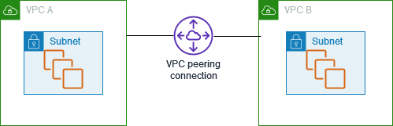
VPC Peering - Architecture Diagram
• Direct Peering Connection between VPC A and VPC B.
• Private IP traffic flows directly between VPCs.

Slide 6
What is AWS Transit Gateway?
• Central hub for connecting VPCs, VPNs, and Direct Connect
• Supports transitive routing between all attached networks
• Simplifies network management and scaling

Slide 7
Transit Gateway - Key Features
• Supports thousands of VPC attachments
• Centralized route management
• Supports inter-region peering

Slide 8
Transit Gateway - Use Cases
• Large multi-account, multi-VPC environments
• Centralized security and inspection (e.g., via firewall VPC)
• Hybrid cloud environments (on-prem to cloud)

Slide 9
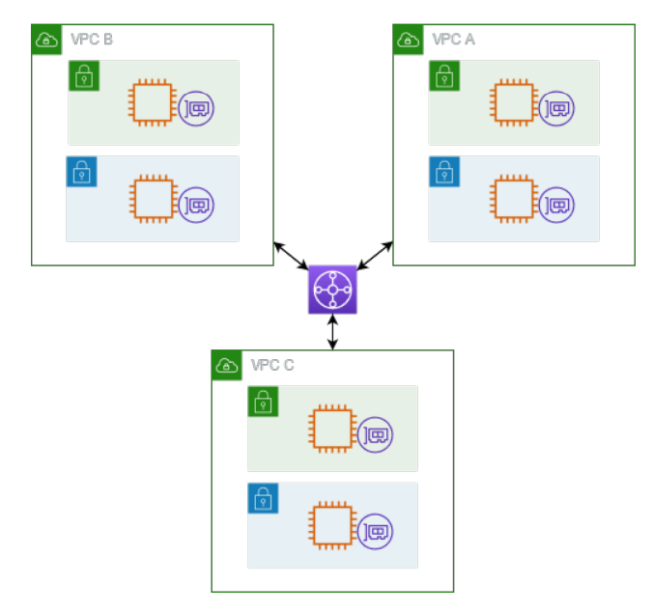
Transit Gateway - Architecture Diagram
• Multiple VPCs connected to Transit Gateway
• Centralized routing via Transit Gateway
• Supports transitive routing

Slide 10
What are VPC Endpoints?
• Private connectivity to AWS services over AWS network
• Two types:
- Interface Endpoints (powered by ENI)
- Gateway Endpoints (used for S3, DynamoDB)

Slide 11
VPC Endpoint - Interface Endpoint
• Creates an Elastic Network Interface in your VPC
• Connects to AWS services like SQS, SNS, EC2 APIs
SQS (Simple Queue Service),SNS (Simple Notification Service), application programming interfaces (APIs)
• Traffic stays within AWS private network

Slide 12
VPC Endpoint - Gateway Endpoint
• Adds a route table entry to AWS services
• No ENI creation, uses route table modification
• Simple and cost-effective for supported services

Slide 13
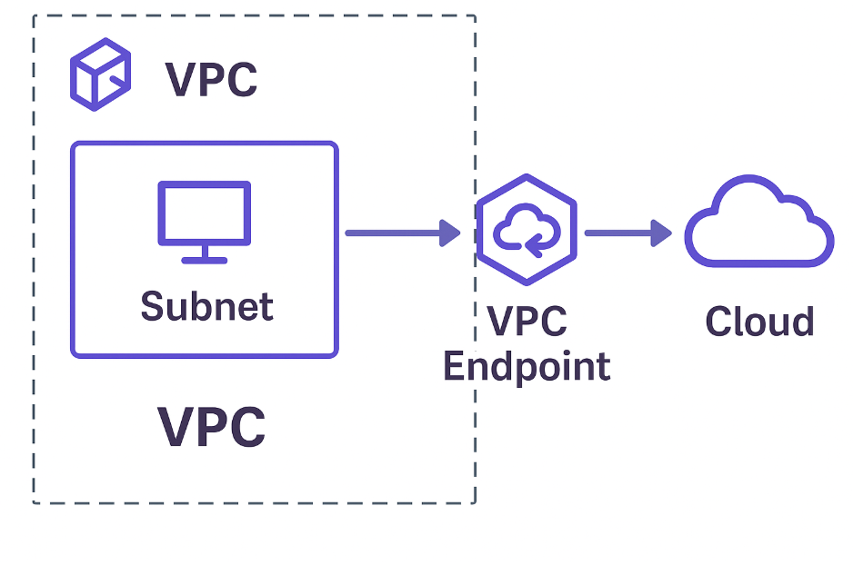
VPC Endpoints - Architecture Diagram
• VPC uses Interface Endpoint for services like SNS
• VPC uses Gateway Endpoint for S3 access

Slide 14
Comparison Table
Feature | Peering | Transit GW | Endpoint
Scope | VPC-VPC | Central Hub | AWS Services
Transitive Routing | | ❌ | ✅ | N/A
Scalability | Low | High | N/A
AWS Services Access | ❌ | ❌ | ✅

Slide 15
When to Use What?
• Peering: Simple, direct VPC connections
• Transit Gateway: Complex, scalable multi-VPC, multi-account setups
• Endpoints: Private, secure access to AWS services without Internet Gateway

Slide 16
Best Practices
• Use Transit Gateway for centralized, scalable connectivity
• Use Peering for simple, few VPC setups
• Use Endpoints to access AWS services securely within AWS network

Slide 17
Conclusion
• VPC Peering, Transit Gateway, and Endpoints are key AWS networking services
• Choose based on scale, use case, and required connectivity type
• Always plan for scalability, security, and cost

Slide 18
THANK YOU

